Slide 1

Scientific Figure Synthesis

Slide 2
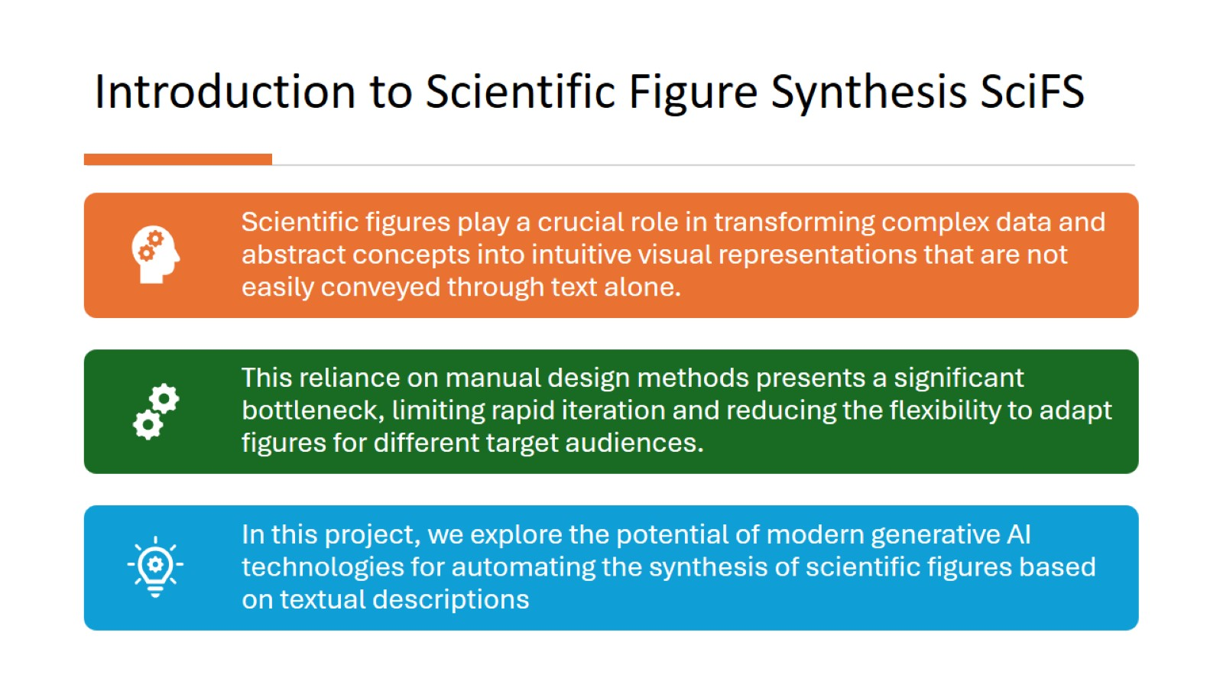
Introduction to Scientific Figure Synthesis SciFS

Slide 3
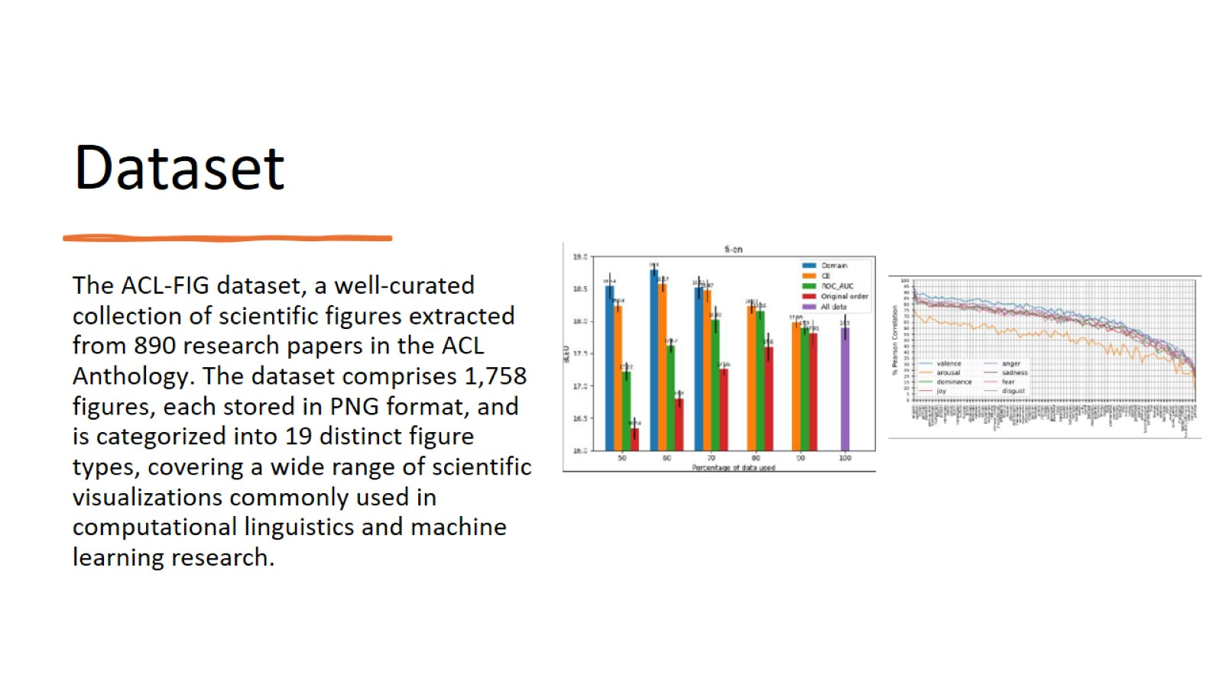
Dataset

Slide 4
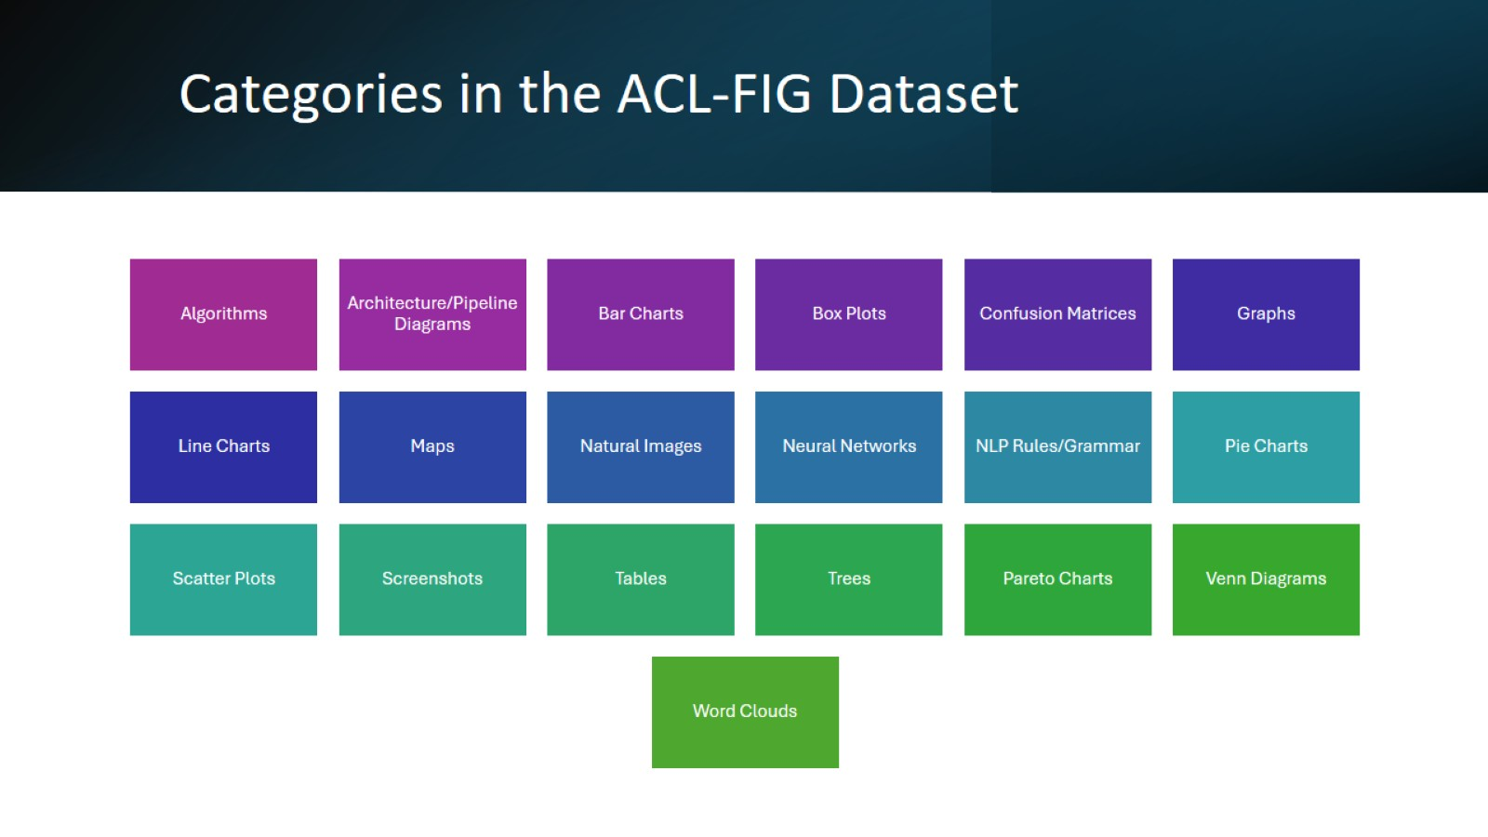
Categories in the ACL-FIG Dataset

Slide 5
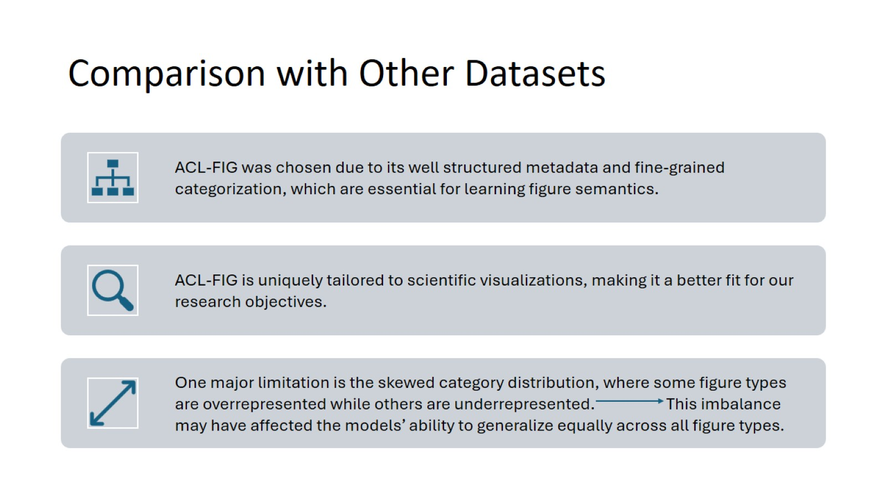
Comparison with Other Datasets

Slide 6
Figure Synthesis based on Image-Generation Techniques
Generative Adversarial Networks (GANs)
Latent Diffusion Models (LDMs)
Vision Transformers (ViTs).

Slide 7
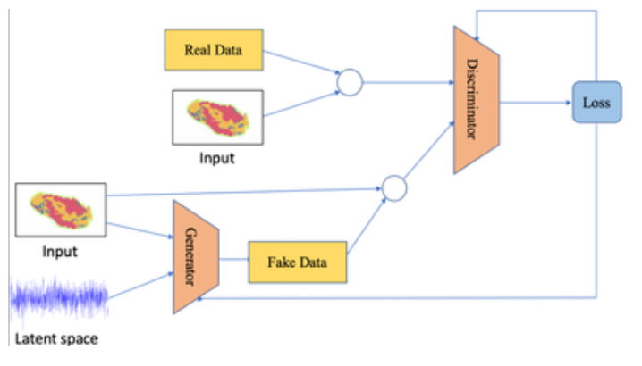
GAN-based Figure Synthesis
Α class of deep learning models designed to generate synthetic data that resembles real-world samples.
They consist of two neural networks:
• Generator (G): Learns to create synthetic samples from random noise.
• Discriminator (D): Learns to distinguish real samples from fake ones produced by the generator.

Slide 8
Generator
Label Embedding
converts class indices into learnable vectors
Linear Projection and Upsampling
a single latent vector that is projected to a higher-dimensional space and reshaped into a small feature map.
Convolutional Refinement
several convolutional layers, batch normalization, Leaky ReLU and Tanh.

Slide 9
Discriminator
Label Embedding
decision-making process on class-specific information
Flattening and Concatenation
Label embedding is concatenated with the image vector to form a single input representation
Fully Connected Classifier
several fully connected layers, Leaky ReLU and sigmoid activation

Slide 10
Experiments on GAN-Based Figure Generation
Label Consistency: Determining whether generated figures accurately correspond to their assigned categories.
Mode Collapse: Evaluating the diversity of generated figures across multiple noise inputs.
Visual Fidelity: Assessing the structural integrity, coherence, and overall clarity of generated images.

Slide 11
Visual Evaluation of Generated Figures
Blurry and Incomplete Figures: Generated images frequently exhibited low clarity, with missing axes, misaligned gridlines, and distorted structural elements.
Noise-Dominated Outputs: Many images appeared as random noise textures rather than recognizable scientific visualizations.
Lack of Semantic Alignment: The figures often failed to resemble their corresponding categories, demonstrating weak conditional mapping between labels and visual output.
Mode Collapse: The generator repeatedly produced near-identical outputs across different noise vectors, failing to capture a diverse range of figure structures.

Slide 12
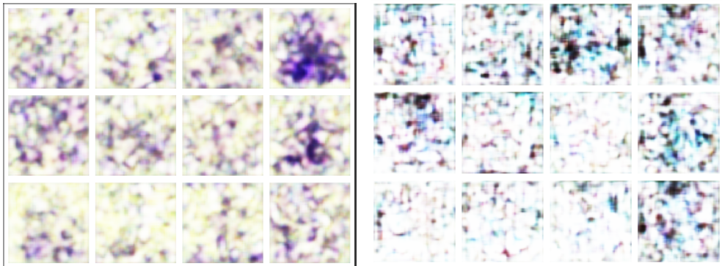
Result Example
Tree chart
Neural Network chart

Slide 13
Results and Observations
• The low IS score (≈ 1.47 ± 0.10) indicates that the generated images exhibit minimal diversity and fail to produce well-distinguished outputs across different figure categories.
• The high FID score (≈ 315.0) highlights a substantial discrepancy between real and generated figures, reinforcing the conclusion that the synthesized images lack geometric coherence.
• Loss analysis and latent space activations reveal inconsistent training behavior, with the generator struggling to balance adversarial feedback.

Slide 14
Failure Cases and Limitations
Limited Model Capacity
Small Dataset Size
Impossibility of High-Quality Figure Generation in Our Implementation

Slide 15
Possible Solutions
Larger dataset
More expressive model architecture
More computational resources

Slide 16
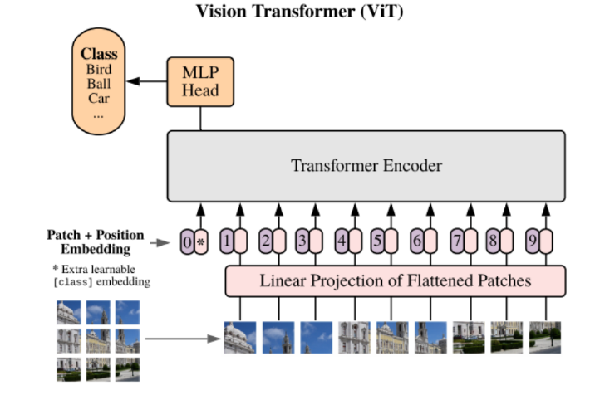
Vision Transformer-based Figure Synthesis
ViTs are deep learning models that process images by dividing them into non-overlapping patches and treating each patch as an input token, similar to words in natural language processing transformers.

Slide 17
Model Architecture and Training Considerations
We employed the vit small patch16 224 model from the timm library
01
The encoder processes images by dividing them into patches of size 16×16
02
Made into a sequence of embedded feature vectors that serve as input to the Transformer layers
03

Slide 18
Key Modifications and Considerations
Removing the classification head
Normalization in the latent space (Tanh activation function)
Efficient memory usage (cudnn.benchmark, cudnn.enabled)
Image Preprocessing (images resized to 224x224)

Slide 19
Decoder Architecture
Fully connected layer for reshaping
Instance Normalization
Sigmoid activation in the final layer

Slide 20
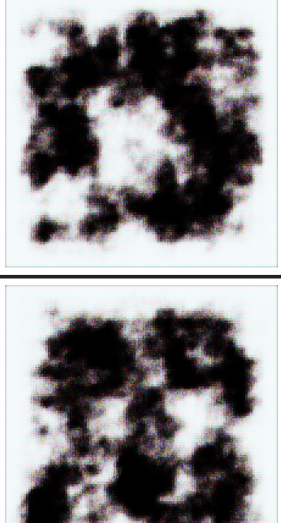
Visual Evaluation of Generated Figures
Blurry and Diffuse Structures
High Contrast but Poor Detail
Incomplete or Abstract Forms

Slide 21
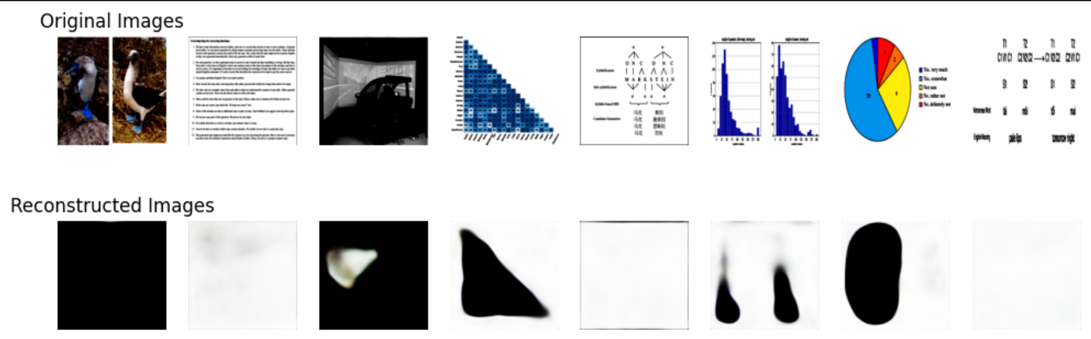
Comparison Between Original and Reconstructed Images

Slide 22

Results and Observations
IS Score Improvement: The ViT model achieved an Inception Score of ≈ 4.12±0.15
Lower FID Score: The ViT model attained a Fr´echet Inception Distance of ≈ 135.3,

Slide 23
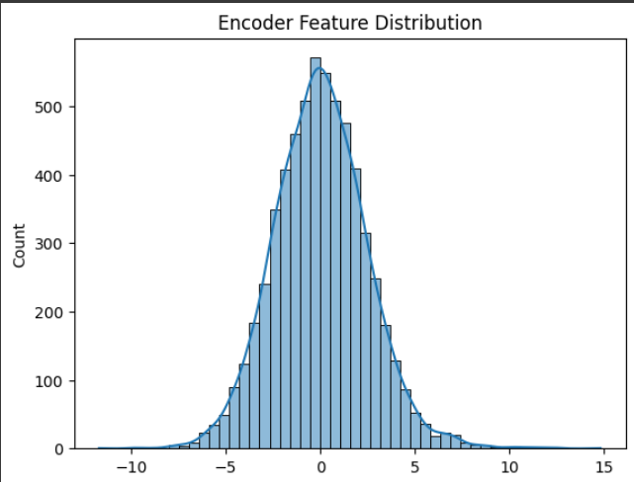
Limitations Due to Dataset and Model Size
Small Dataset Size
Limited Model Capacity
However, the spread of feature values indicates that the model learns meaningful embeddings

Slide 24
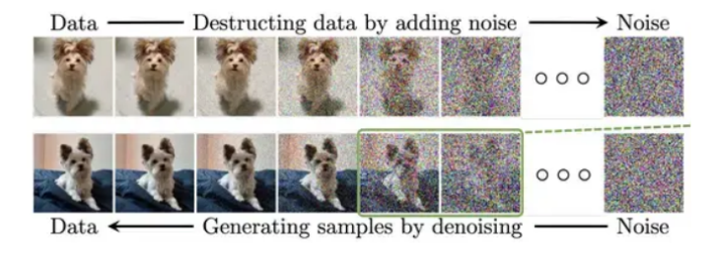
Diffusion-based Figure Synthesis
What are Diffusion Models?
A class of generative models that iteratively refine noise into meaningful images.
Achieve state-of-the-art performance in image generation.
How Do They Work?
Forward Process (Diffusion): Gradually adds Gaussian noise to an image over multiple steps, destroying its structure.
Reverse Process (Denoising): Trains a neural network to reverse the noise at every timestep, recovering the original data step by step.

Slide 25
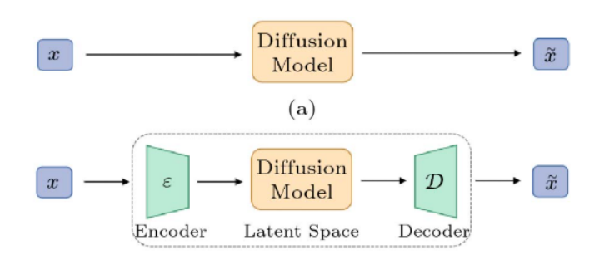
Latent Diffusion Models (LDMs)
What are Latent Diffusion Models?
A more efficient version of diffusion models that operates in a lower-dimensional latent space instead of pixel space.
They reduce computational cost while maintaining high-quality generation.
How Do They Work?
Encode – A pre-trained Variational Autoencoder (VAE) compresses images into a latent representation.
Diffuse – Noise is gradually added and then denoised in this latent space.
Decode – The denoised latent representation is transformed back into an image using the VAE decoder.

Slide 26
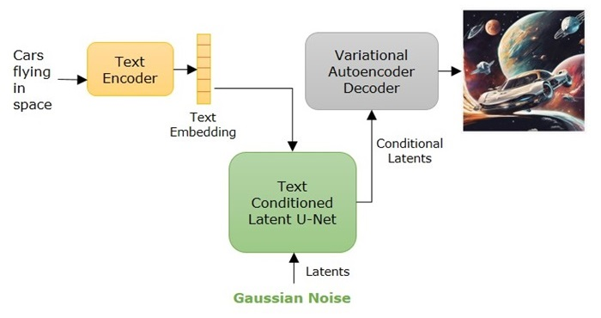
Stable Diffusion
Stable Diffusion is an advanced text-to-image generative model based on LDMs.
It enables high-quality image generation conditioned on text prompts.
Stable Diffusion Architecture (our implementation):
Cross-attention
VAE
CLIP text encoder
Denoising U-Net

Slide 27
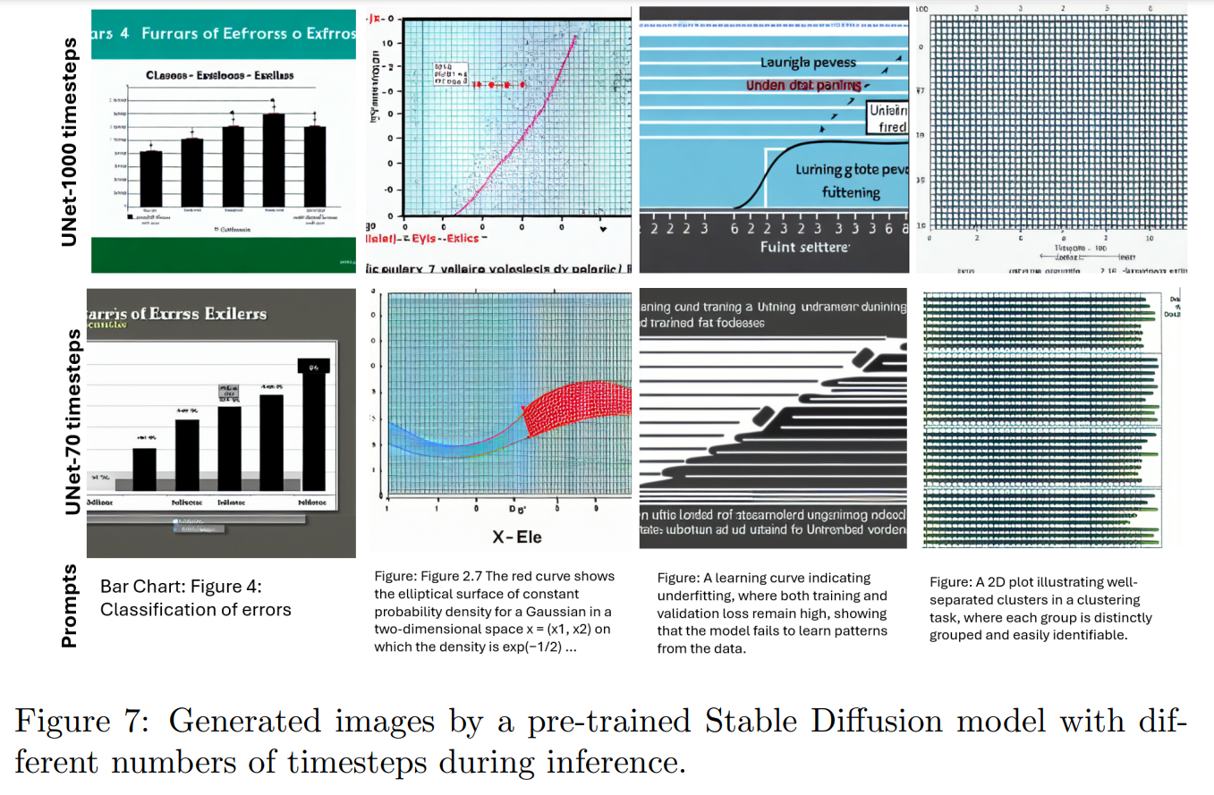

Pre-Trained Stable Diffusion Experiments with various timesteps

Slide 28
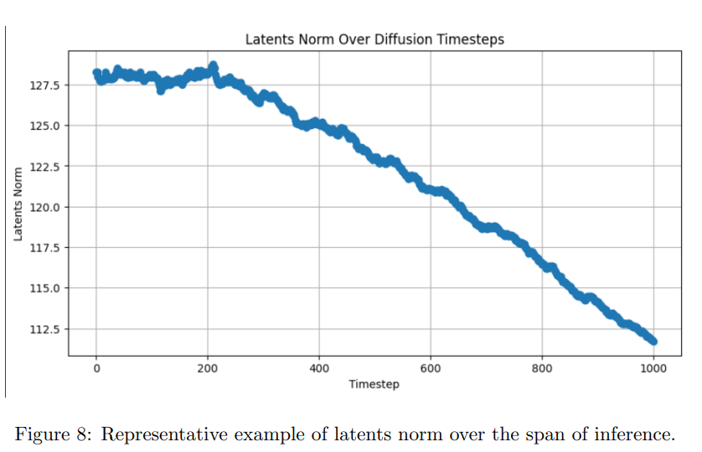
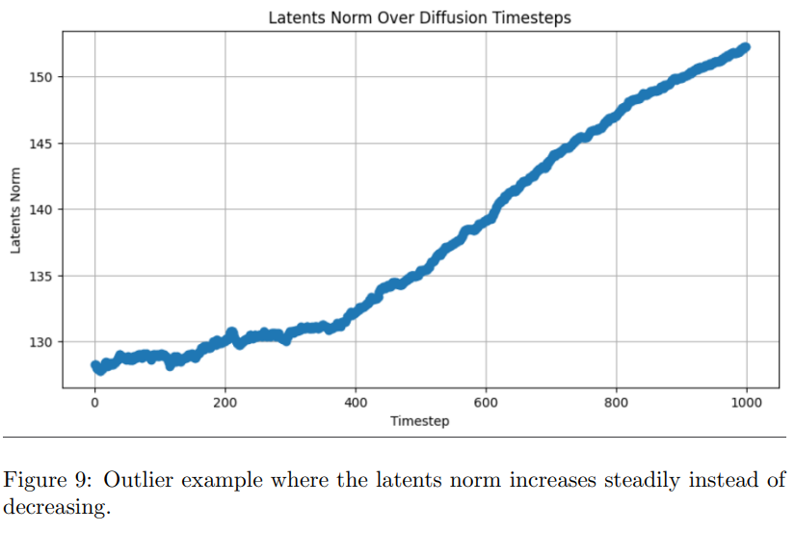

Pre-Trained Stable Diffusion Experiments with various timesteps
This work utilizes classifier-free guidance which determines how much the conditional prediction influences the final denoising step. The U-Net predicts u and t, unconditional and conditional noise estimates, respectively.
The final prediction, is computed as u + g · (t − u) , where g is the guidance scale.
Notes:
Initially, the latents start as pure Gaussian noise, which has a high norm. As denoising progresses, the model gradually removes noise while shaping the latents into structured features that resemble the target image. This leads to a reduction in overall variance and a decrease in norm magnitude.

Slide 29
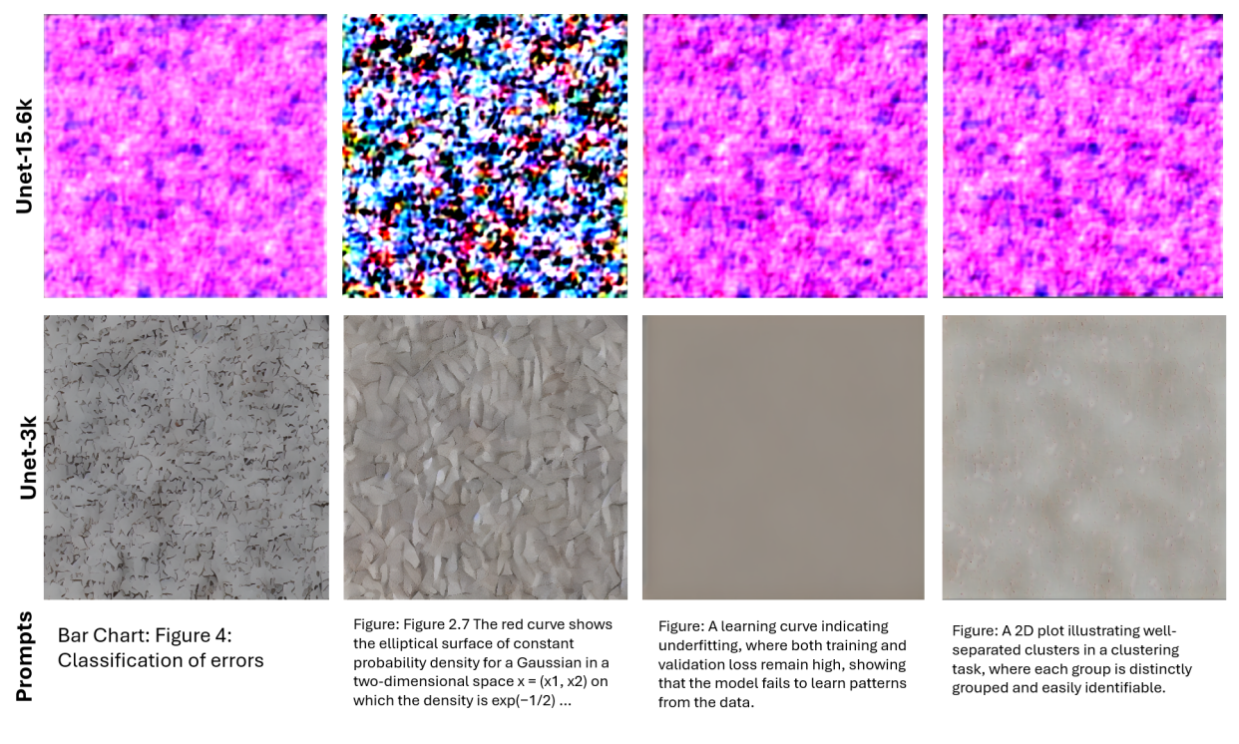
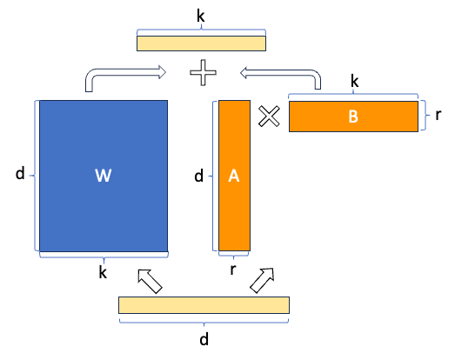
Fine-tuned Stable Diffusion Experiments with various training corpora
We finetuned the U-Net using the PEFT technique Low Rank Adaptation (LoRA).
Pre-trained weights
Trainable vectors

Slide 30

Fine-tuned Stable Diffusion Experiments with various training corpora
Challenges During Training:
Limited Training Data: Small dataset size.
High Data Diversity: Few and highly varied examples per class.
Ambiguous Captions: Captions often lack descriptive detail.
Resulting Fine-Tuned Behavior:
Mode Collapse: The model overfitted to a subset of dominant patterns (e.g., specific colors and shapes) rather than capturing the full diversity of figures.
Future Improvements:
Extended Training: Use a learning rate scheduler to stabilize optimization.
Dataset Augmentation: Enhance diversity through synthetic variations.
Improved Text Annotations: Automatically generate detailed image descriptions instead of using simple captions.
Pre-trained weights

Slide 31
Moving into a different direction…
Figure Synthesis based on Code-Generation Techniques

Slide 32
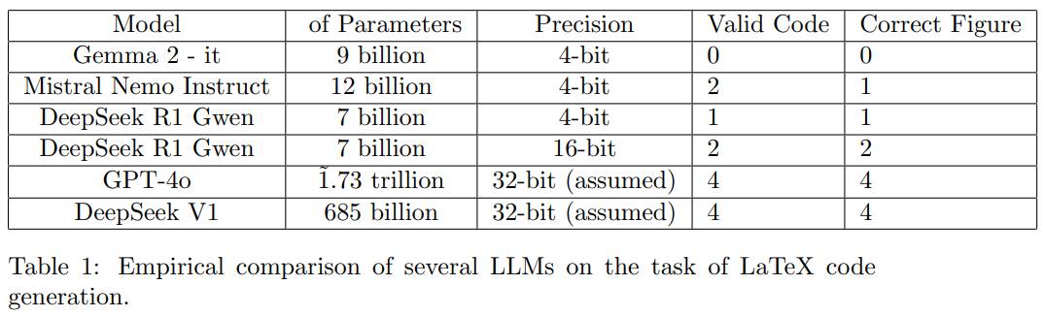
Code-Generation Techniques using LLMs

Slide 33
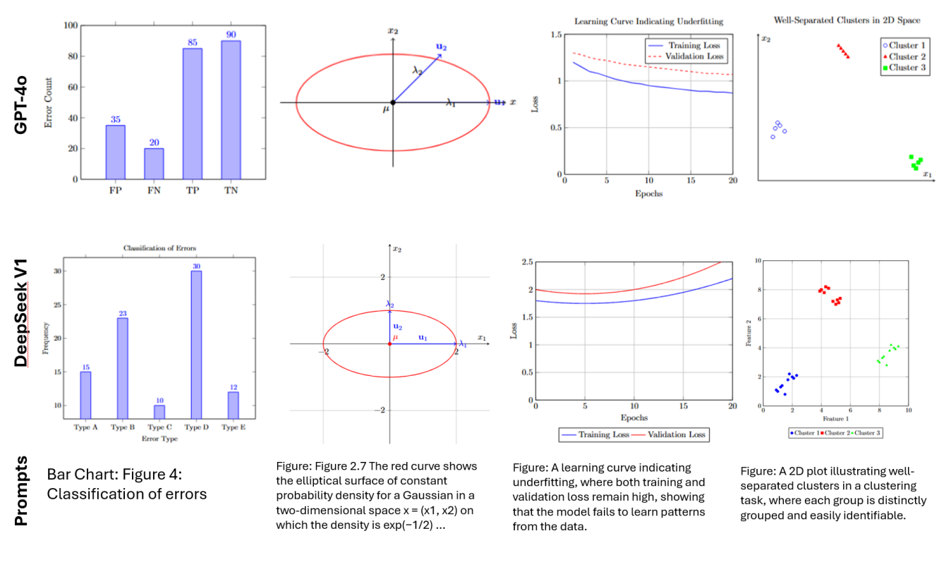
State of The Art (SoTA) LLM Experiments:

Slide 34
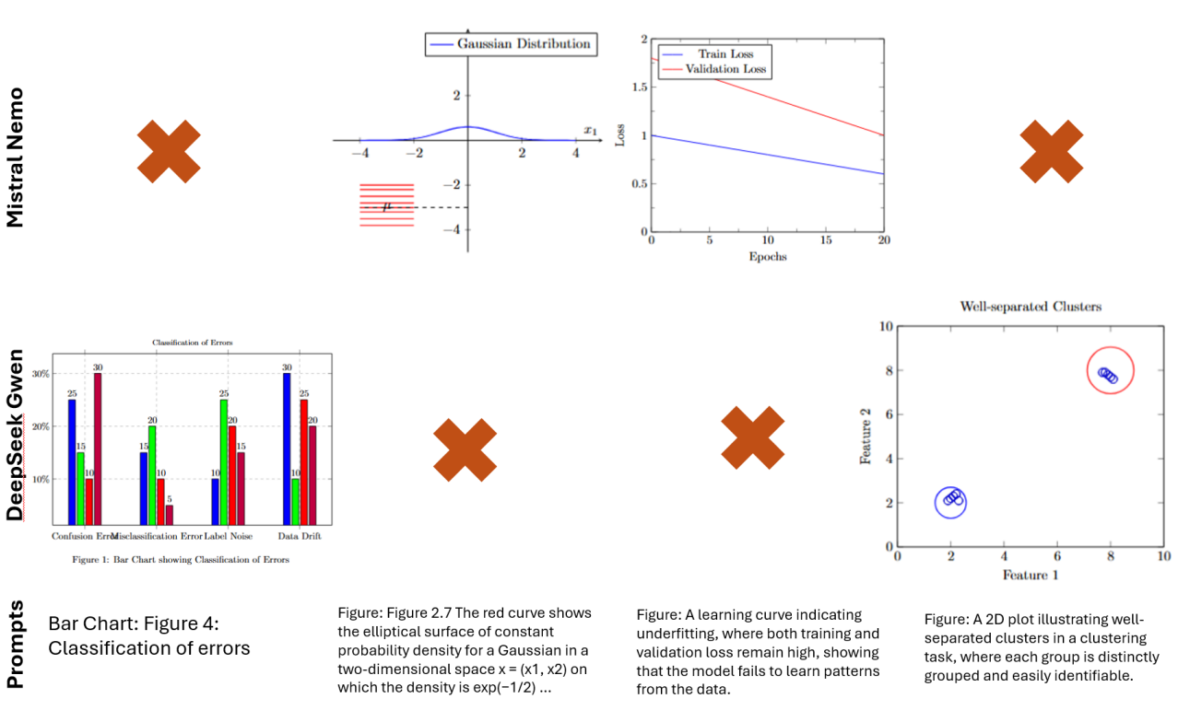
How do modern LLMs perform on a budget?
Not great…

Slide 35
Can we improve performance without fine-tuning?
Prompt Engineering:
Prompting Strategies for LaTeX Figure Generation
Zero-Shot
Baseline performance without additional context.
Minimal token prompt reduces interference with inherent reasoning.
Guided Few-Shot
Provides caption/LaTeX pairs in a text-completion format.
Helps the model learn structured LaTeX generation through in-context learning.
Useful when pre-trained knowledge lacks LaTeX-specific details.
Example-Based Few-Shot
Presents multiple caption/LaTeX pairs as examples rather than in a text-completion manner.
Leverages DeepSeek’s natural stepwise reasoning without enforcing a strict format.
May lead to more natural LaTeX generation.
Chain-of-Thought (CoT)
Encourages intermediate logical steps before generating the final output.
DeepSeek already performs stepwise reasoning, so this tests whether explicit CoT enhances or disrupts its reasoning..

Slide 36
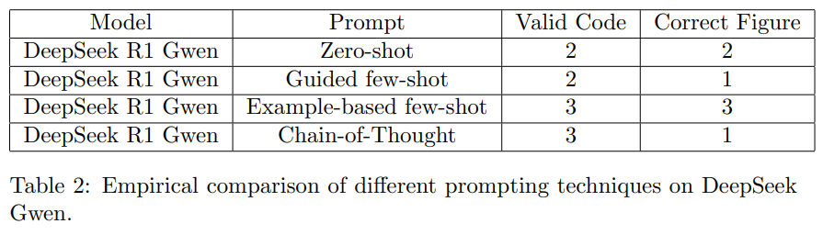
Can we improve performance without fine-tuning?
Prompt Engineering:

Slide 37
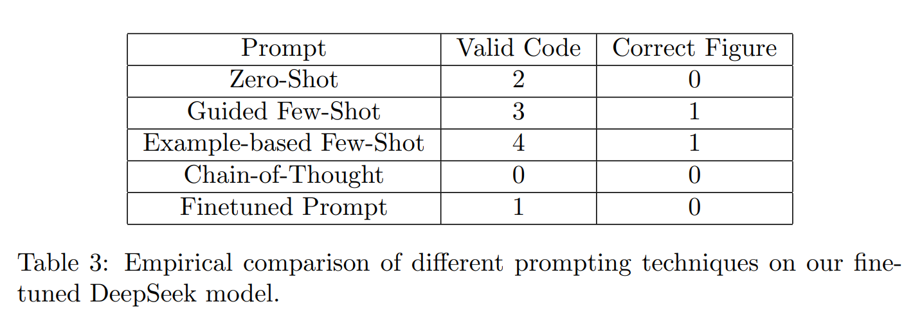
Finetuning DeepSeek Gwen for improved LaTeX understanding and generation:
Quant. + LoRA | “Finetuned” Prompt

Slide 38
Why Fine-Tuning Failed:
Small Training Set – Our dataset of ~50 samples wasn’t large enough for meaningful LaTeX learning, even for LLMs that are known for fast and efficient learning.
Disrupted Reasoning – Fine-tuning without Chain-of-Thought likely broke its natural stepwise thinking.

Slide 39
Future Work & Improvements
Enhanced Fine-Tuning – Train small-scale LLMs with a larger dataset and a Chain-of-Thought approach for better reasoning.
Unsupervised Dataset Generation – Leverage larger, more capable models to automatically create training data.
Interactive Refinement – Enable user feedback to correct and improve generated LaTeX code.
Smarter Training Loss – Use semantic similarity metrics tailored to LaTeX figures for better optimization.
Advanced Image Generation – Expand datasets and increase complexity to capture scientific literature’s high-level semantics.
Template-Based Image Generation – Structure output within predefined template spaces for more controlled and precise figure creation.
🚀

